Slide 1
DESIGN AND ANALYSIS OF ALGORITHMS
Travelling Salesman
Problem
Finding the optimal route
Name: Harshita Kanwar
PRN: 25070521330
Section: C
Notes:
Today we turn a routing problem into a graph problem, compare exhaustive search with branch and bound, and see why the same exact answer can require very different amounts of work.

Slide 2

THE PROBLEM
One salesperson. Every city. One best loop.
START
Find a closed tour that visits every city exactly once and minimizes total travel cost.
Start from a chosen city.
DELIVERY ROUTES · SERVICE CALLS · INSPECTION ROUNDS
VISIT
Visit every other city exactly once.
RETURN
Return to the start with minimum total cost.
02
Notes:
Fixing the start city removes rotational duplicates. The remaining challenge is ordering every other city while keeping the total distance, time, or cost as small as possible.

Slide 3
MODEL THE ROUTE
TSP turns a map into a weighted graph
10
A
B
20
35
VERTEX
15
A city.
25
EDGE
D
C
A possible journey.
30
WEIGHT
Distance, time, or cost.
GOAL
Minimum-weight Hamiltonian cycle.
03
Notes:
The abstraction is simple: cities become vertices, possible journeys become edges, and each edge carries a weight. A valid TSP solution is a Hamiltonian cycle: every vertex appears once, then the route returns to its start.

Slide 4
WORKED EXAMPLE
The best tour costs 80
10
A
B
Distances: AB=10, AC=15, AD=20, BC=35, BD=25, CD=30
15
OPTIMAL · 80
25
Tour | Arithmetic | Cost
1 | A → B → D → C → A 10 + 25 + 30 + 15 | 80
2 | A → C → B → D → A 15 + 35 + 25 + 20 | 95
C
D
30
For this instance, Candidate 1 is optimal.
04
Notes:
We can compare complete tours directly. The first candidate totals 80; the second totals 95. The highlighted cycle is the optimum for this four-city instance.

Slide 5
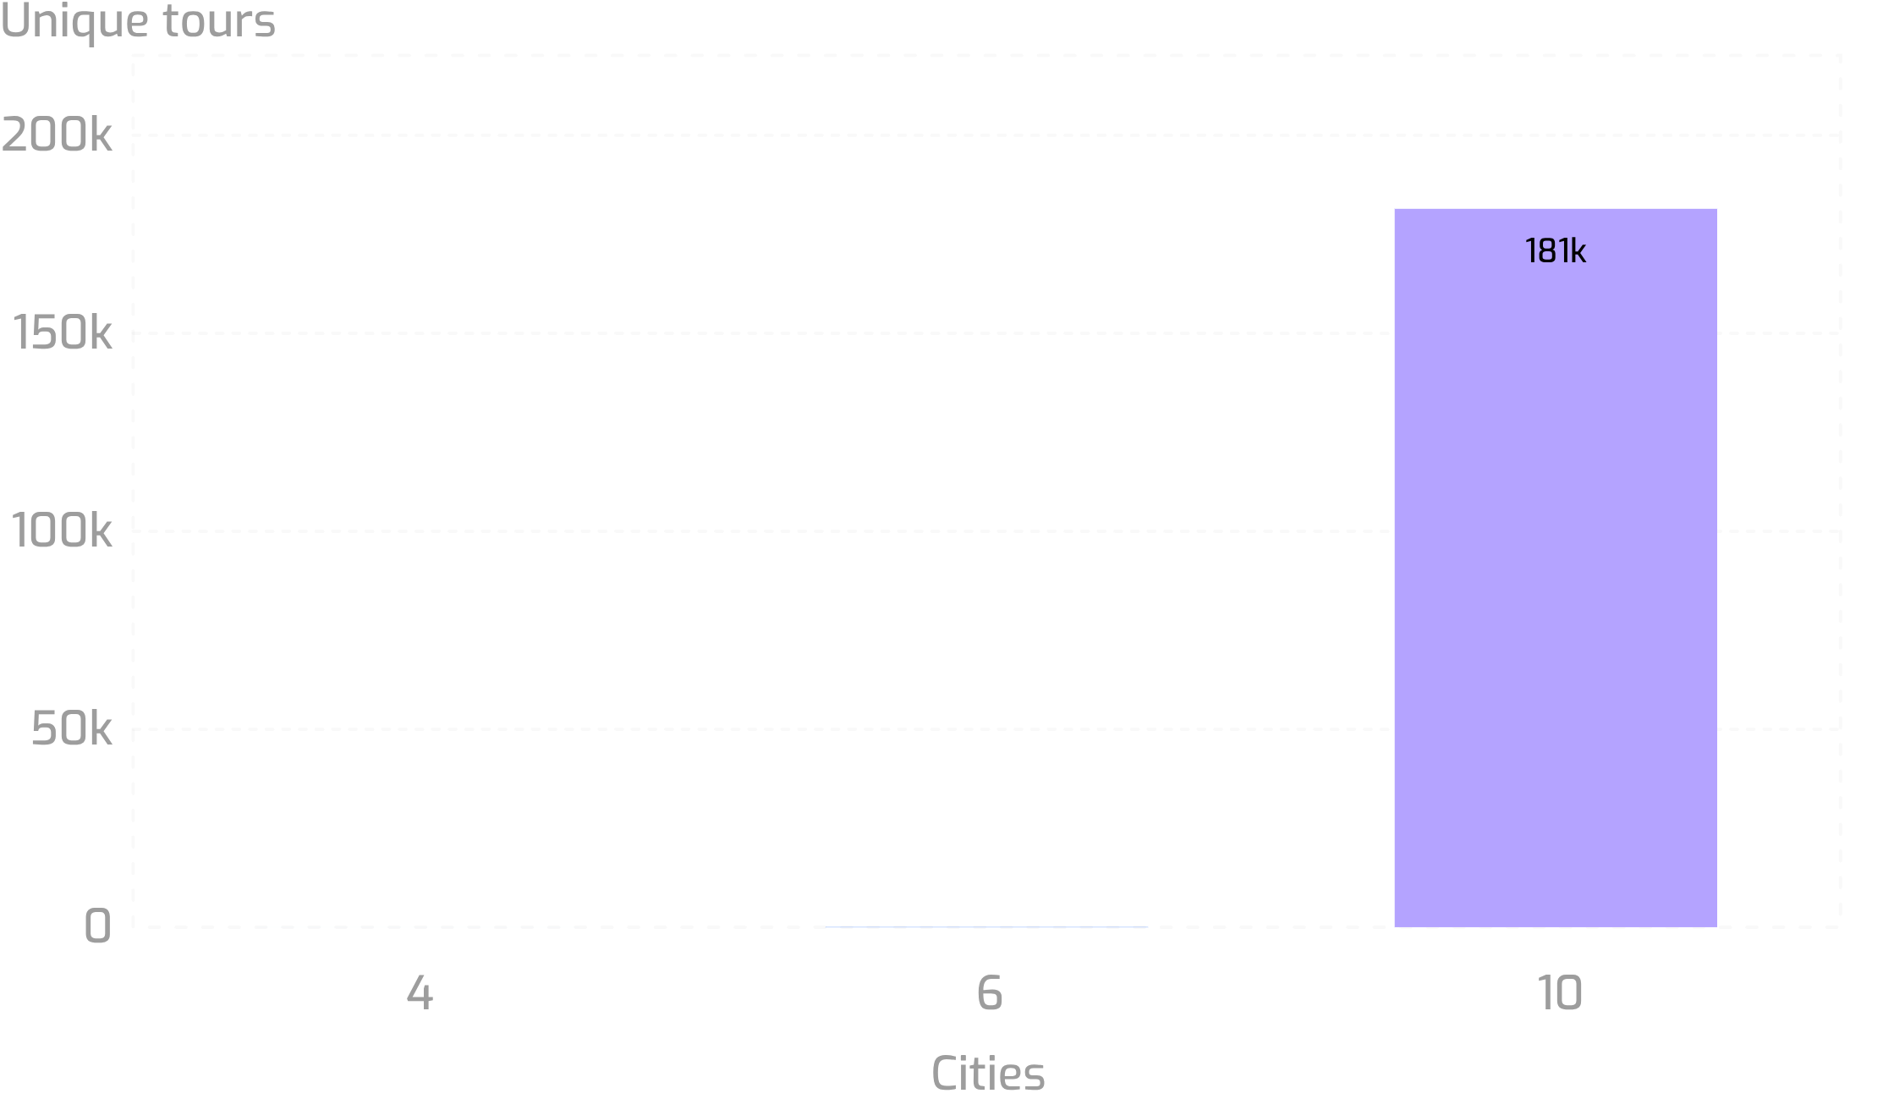
WHY SEARCH IS HARD
The search space explodes
Fix the start city to A. The remaining cities can still be arranged in many orders.
DIRECTED TOURS
(n−1)!
SYMMETRIC DISTANCES
Reverse tours duplicate each other.
Unique tours after fixing A: 4 → 6 · 6 → 60 · 10 → 181,440
UNIQUE TOURS
(n−1)! / 2
05
Notes:
Fixing A removes rotational duplicates, leaving (n−1)! directed tours. With symmetric distances, a route and its reverse have the same cost, so only half remain unique. The factorial curve becomes the central obstacle.

Slide 6



BRUTE FORCE ALGORITHM
BASELINE METHOD
Brute force: exhaustive, exact, expensive
bestCost ← ∞
bestTour ← none
for each permutation P of {B, …, n}:
tour ← [A] + P + [A]
cost ← 0
for i ← 0 to n−1:
cost ← cost + d[tour[i]][tour[i+1]]
if cost < bestCost:
bestCost ← cost
bestTour ← tour
return bestTour, bestCost
01
02
03
04
Generate
Close
Calculate
Keep
Every permutation after A.
Return each route to A.
Sum its edge costs.
Replace the incumbent if cheaper.
ONE CANDIDATE TOUR, STEP BY STEP
Enumerate
Build the next full tour.
Compute
Sum its edge costs.
Keep best
Store it if cheaper.
EXACT BY ENUMERATION · NO PRUNING
06
Notes:
Brute force is the reference algorithm. It cannot miss the optimum because it evaluates every complete candidate, but its factorial number of tours makes the method expensive as n grows.

Slide 7
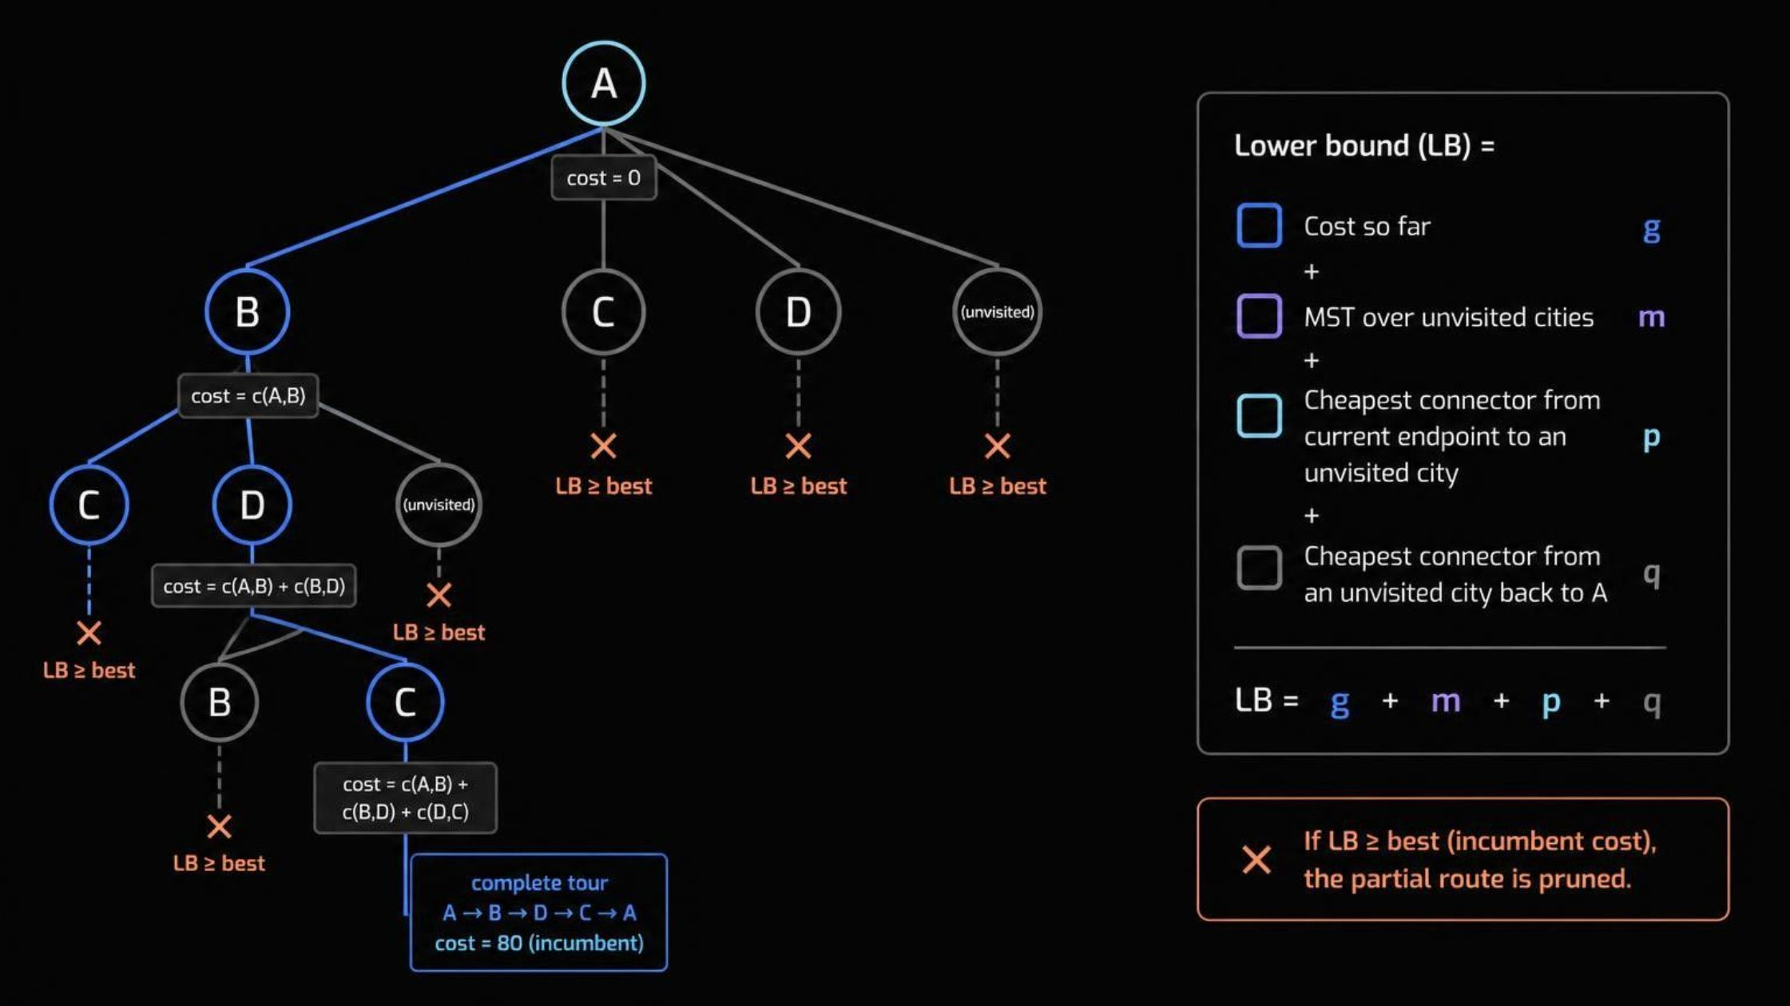
Branch and bound: search smarter, stay exact
BRANCH
Extend a partial route with one unvisited city.
BOUND
Estimate the cheapest possible completion.
PRUNE
Discard a node when its lower bound ≥ incumbent best cost.
A valid lower bound makes every prune safe.
07
Notes:
Branching creates candidate partial routes. Bounding asks whether any completion of a partial route could beat the best complete tour already found. If the lower bound is at least the incumbent, the entire subtree can be discarded without changing the answer.

Slide 8
Branch and bound algorithm
VALID LOWER BOUND
BRANCH → BOUND → PRUNE
bestCost ← ∞
bestTour ← none
PQ ← priority queue ordered by lowerBound
Push initial node [A] into PQ
while PQ is not empty:
node ← pop node with minimum lowerBound
if node.unvisited is empty:
total ← node.cost + d[node.last][A]
if total < bestCost:
bestCost ← total
bestTour ← node.path + [A]
else:
if node.lowerBound ≥ bestCost:
continue
for each city v in node.unvisited:
child ← extend node with v
child.lowerBound ← LB(child)
if child.lowerBound < bestCost:
push child into PQ
return bestTour, bestCost
LB = cost-so-far + MST(unvisited) + connectors
Add the cheapest current-to-unvisited edge and cheapest unvisited-to-A edge.
Priority-first finds strong incumbents early; handle empty or singleton unvisited sets by closing the route.
08
Notes:
The priority queue expands the most promising node first. The bound combines unavoidable costs: the current route, an MST over remaining cities, and the two endpoint connectors needed to complete the cycle.

Slide 9
SAME INSTANCE · DIFFERENT WORK
Same four cities, different search behavior
BRUTE FORCE
Evaluate every unique tour
Compare tour costs 80 and 95 with every other unique tour; return the minimum.
Both methods return the exact optimum:
A–B–D–C–A = 80
BRANCH AND BOUND
Find 80, then prune
What changes is how much of the search they expose before proving that 80 is best.
Cross out any partial route with LB ≥ 80.
Exactness requires a valid lower bound.
Method | Complete tours | Partial routes
Brute force | Every unique tour checked | None cut
Branch and bound | Only tours that survive pruning | Cut when LB ≥ 80
Pruning changes the work, not the answer.
09
Notes:
Brute force must inspect every unique tour. Branch and bound may discover the 80 tour early, then use it as the incumbent. Any partial route whose lower bound is at least 80 cannot improve the answer and is safely pruned.

Slide 10




THE TAKEAWAY
WHERE TSP MATTERS
Complexity and where TSP matters
Delivery logistics
METHOD | WHAT IT GUARANTEES | COST PROFILE
Brute force | Exact optimum | Θ((n−1)! · n) time after fixing A
Branch and bound | Exact optimum with valid pruning | Worst case remains exponential/factorial
Important limit | Exact ≠ polynomial | No guaranteed polynomial-time performance
Manufacturing tool paths
Circuit-board drilling
Inspection and service routing
BOUND QUALITY · CITY ORDERING · INSTANCE STRUCTURE
10
Notes:
The final distinction matters: branch and bound is exact, but it does not become polynomial-time. Its practical effort depends on the bound, the order in which cities are explored, and the structure of the instance. The same pattern appears in logistics, manufacturing, drilling, inspection, and service routing.

Slide 11
Thank You
Questions and discussion welcome
11
Notes:
Thank the audience, invite questions, and open the floor for discussion on the routing problem and branch and bound.

